Slide 1
USDS+<agency>+OPM Hiring Pilot Job Analysis: Day 1
<Insert Date>

Slide 2
Thank you for coming!

Slide 3
Agenda for Today: Tasks Competencies Proficiencies
Write down job tasks and group them to identify competencies
Vote for and discuss critical competencies
Define critical competencies
Create proficiency levels for each competency
Discuss proficiency levels and decide required level

Slide 4
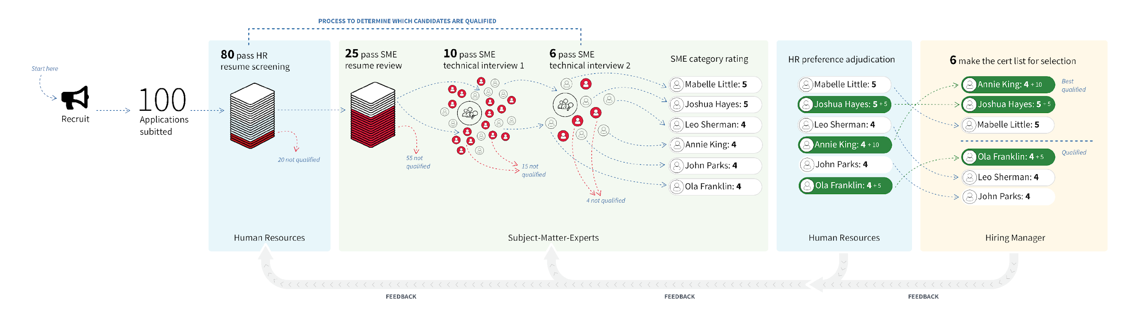
Multi-Hurdle SME Assessment Process
{
You

Slide 5
Example tasks
Responded to customer requests and customer-related incidents
Negotiated procurement with technology vendors
Developed information tracking procedures
Interpreted data and other information
Collected and analyzed internet services usage and performance statistics

Slide 6
write down The job tasks for this position
Be specific—actual tasks performed in the past month.
The tasks should begin with a verb, indicating that they’re an action a person in that position would actively take.
Write one task per sticky note.
We will group similar tasks, then give each group a title.
These titles are the competencies for this job.

Slide 7
Dot Voting and discussion
Use dots to vote for most critical competencies for this position.
Limited number of dots so we can prioritize.
Goal is to select 4–6 critical competencies.

Slide 8
Now we define our critical competencies
Definition should be 1-3 sentences, not a list of job tasks.
Examples
Stakeholder Engagement - Cultivates relationships with key internal and external stakeholders. Has superior negotiation skills that enable successful communication and cooperation across all levels of an organization, including executive leadership.
Analytical Ability - Approaches problems quantitatively and displays critical thinking and problem-solving abilities. Breaks down complex problems into component parts. Defines and tracks key metrics to make data-driven decisions.

Slide 9
Example proficiency levels for a competency
Example Competency: Engineering Considerations Works effectively with engineers as a true partner. Understands the technical stack of a product and how it can impact product design and project schedules. Considers the complexities involved in building technology at massive scale.
Unfamiliar: Has never worked with engineers, or has but not effectively/views them as a different group of people. Views technical matters as someone else's problem, and seems uninterested in learning more about a project's technical foundations. Unable to describe a project's technical stack.
Familiar: Has some experience working effectively with engineers. Displays a basic understanding that technical choices impact product design and project schedules. Shows an active interest in learning more about a project's technical foundations.
Experienced: Repeated track record of working as a true partner with engineers. Describes situations where they have engaged in technical decisions or shifted product or project plans due to technical issues. Understanding some of the complexities of building technology at massive scale.
Master: Functions as a true partner with engineers in all technical products and projects in which they are involved. Able to identify potential technical concerns with proposals before consulting engineers. Repeatedly engages in technical decisions and supports engineering needs.

Slide 10
Determining Proficiency levels
The proficiency levels can involve these types of differences:
Scale of activity: The applicant did something at a small organization -vs- did something at a large organization.
Seniority: The applicant did something as part of a group -vs- lead the group that did something.
Level of detail: The applicant can explain a general concept -vs- can discuss the concept in detail.
Note: Requiring particular certifications can be problematic.

Slide 11
Final step – decide proficiency level for this position for each Competency
Once you've defined the competencies and their proficiency levels, you establish what is minimally required from day one.
The same set of competencies can be used for different positions because roles that require more seniority set the minimum qualification bar higher than more junior roles.

Slide 12
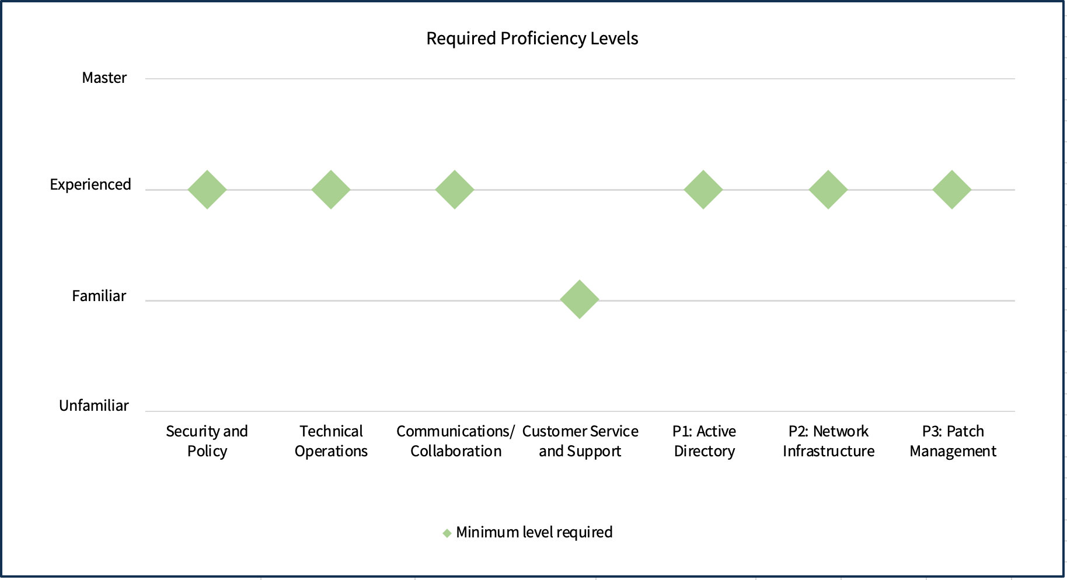
Example of proficiency levels for an IT Specialist at another agency

Slide 13
The End

